Slide 1

Recommend strategy for Big Mountain resort Project Report
Data Science Team

Slide 2
Contents
Problem identification
Recommendation and key findings
Modeling results and analysis
Summary and conclusion

Slide 3
Problem identification
Context
Big Mountain Resort has recently installed an additional chair lift that increases their operating costs by $1,540,000 this season.
This hampers investment strategy.
We need to find out how to select a better value for their ticket price.
Goal
Recoup the increased operational cost $1.54M
Keep the profit margins at 9.2% after executing the strategy

Slide 4
Recommendation and key findings
Three strategies:
Big Mountain Resort ticket price can increase to $96.39 based on model ( currently adult ticket at weekend is $81/per day ).
Closing 7 the least used runs to reduce costs that can’t affect the price of ticket greatly.
Installing an additional chair lift, and charge an adding ticket price by $1.36. Finally the investment can gain good profits after deducting costs.

Slide 5
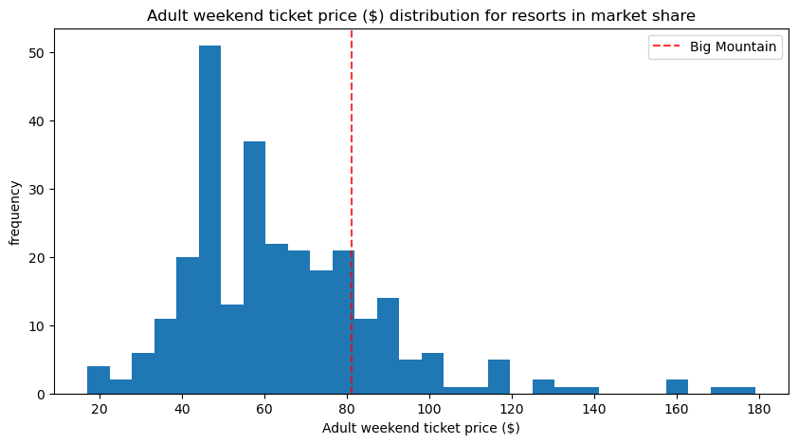
Big Mountain Resort modelled price is $96.39, actual price is $81. This suggests there is room for an increase.
Modeling results and analysis

Slide 6
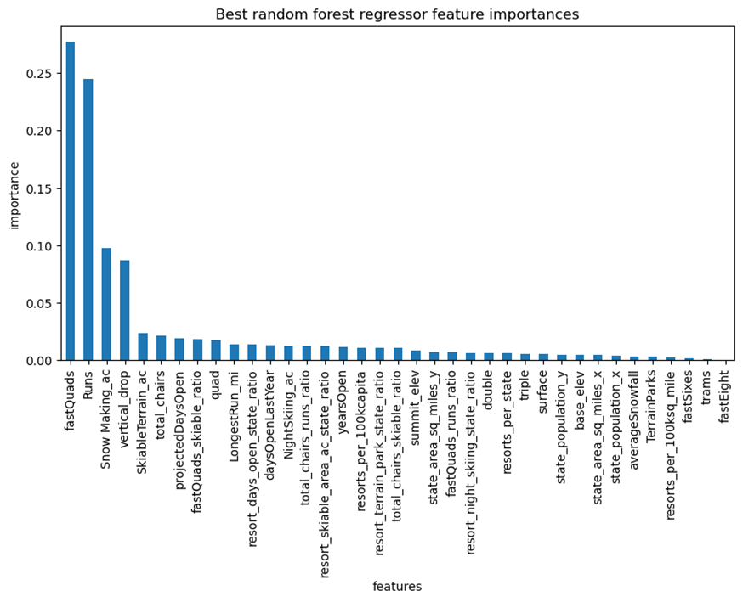
What features support the price of ticket?
The dominant top four features :
fastQuads
Runs
Snow Making_ac
vertical_drop

Slide 7
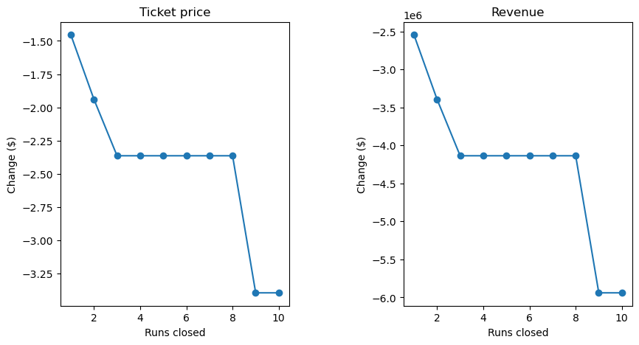
Scenario 1 : Close up to 10 of the least used runs
We may close down 4 or 7 used runs, there's no further loss in ticket price.

Slide 8
Scenario 2: increasing the vertical drop by 150 feet Scenario 3: Scenario2 + 2 acres of snow making
This scenario increases support for ticket price by $1.36
Over the season, this could be expected to amount to $2386364
Such a small increase in the snow making area makes no difference!

Slide 9
Scenario 4: increasing the longest run by .2 miles
increasing the longest run by .2 miles and guaranteeing its snow coverage by adding 4 acres of snow making capability.
No difference whatsoever.

Slide 10
Summary and conclusion
Big Mountain can also raise the ticket price to $96.39 to increase the revenue.
Based on now data, Big Mountain can consider closing one or 2 and 3 run to reduce costs and maintain the ticket price. Or Big Mountain can close 7 the least used runs to reduce costs greatly while lowering the price slightly.
It is assumed that the additional chair lift would increase the operating cost by $1.54 million. Big Mountain can install an additional chair lift, and charge an adding ticket price by $1.36, finally the investment can gain good profits after deducting costs.

Slide 11
Thanks for the support!

